Slide 1
9. Composite hypotheses

Slide 2
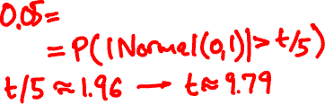

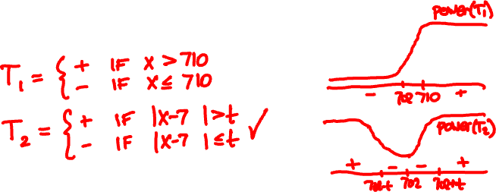
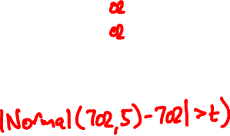

The official height of Ma On Shan is 702m.
Alice claims it is not 702m. σ = 5m. What now?

Slide 3

Likelihood ratio for composite hypotheses
sup f(x | θ)
Λ(x) =
H₁
sup f(x | θ)
H₀
+ if Λ(x) > t
T(x) =
– if Λ(x) ≤ t
t is determined by the type I error
sup P(T(X) = +| θ)
H₀

Slide 4
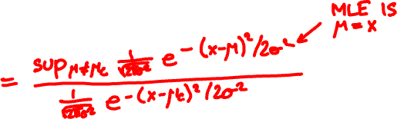
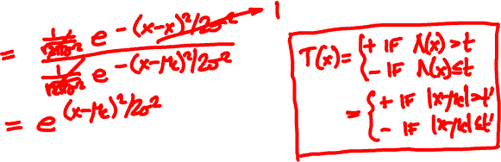
X is Normal(μ, σ)
H₀ = “μ = μ_{c}”
H₁ = “μ ≠ μ_{c}”
sup f(x | μ)
Λ(x) =
H₁
sup f(x | μ)
H₀

Slide 5
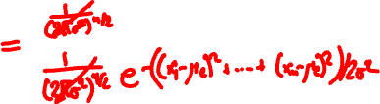


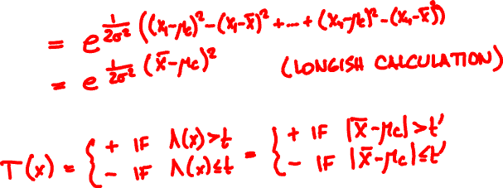
X₁, …, X_{n} independent Normal(μ, σ)
sup f(x₁,…, x_{n} | μ)
H₁ = “μ ≠ μ_{c}”
Λ(x) =
H₁
sup f(x₁,…, x_{n} | μ)
H₀ = “μ = μ_{c}”
H₀

Slide 6
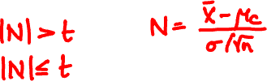



Two-sided test for normal mean
X₁, …, X_{n} independent Normal(μ, σ)
H₀ = “μ = μ_{c}”
H₁ = “μ ≠ μ_{c}”
+ if
T =
– if
p-value =

Slide 7


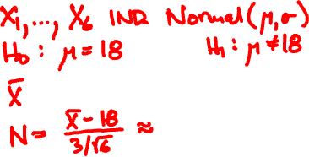
The average HK temperature in Feb is 18C. Has this year been unusual? Assume σ = 3C
day (Feb) 1 6 11 16 21 26
temp (C) 15 15 19 18 8 17

Slide 8

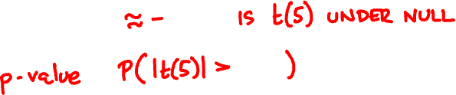
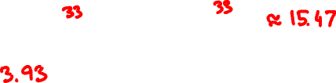
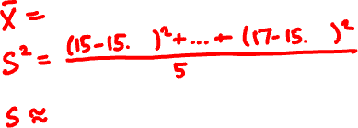
What if σ is unknown?

Slide 9

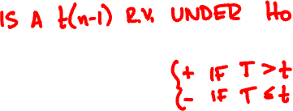

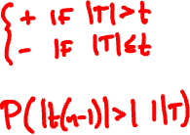


Normal mean, unknown variance
X₁, …, X_{n} independent Normal(μ, σ)
H₀ = “μ = μ_{c}”
H₁ = “μ ≠ μ_{c}”
H₁’ = “μ > μ_{c}”
X – μ_{c}
T =
S/√n
T(x) =
p-value =

Slide 10
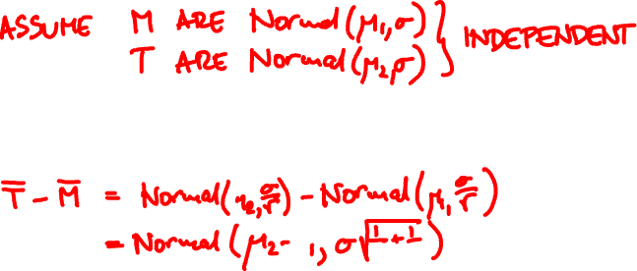
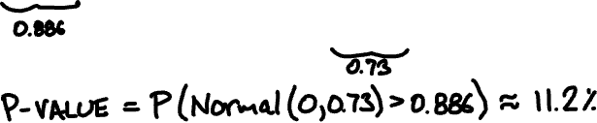


A thermometer with σ = 1℃ reports readings
M: 23.5 23.3 21.3 22.1 23.7
T: 22.8 24.5 23.7
Has the temperature increased?

Slide 11

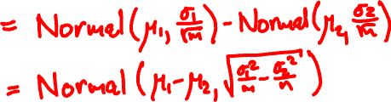
Comparing normal means
X₁, …, X_{m} Normal(μ₁, σ₁)
independent
Y₁, …, Y_{n} Normal(μ₂, σ₂)
Null hypothesis: μ₁ = μ₂
X – Y

Slide 12
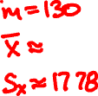
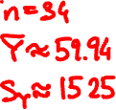
80 74 70 77 70 73 74 67 66 76
69 66 62 66 64 51 48 64 64 54
47 71 63 57 56 54 59 57 41 52
54 35 38 47 33 48 48 40 44 59
32 48 57 48 38 51 56 53 56 47
44 39 52 40 43 43 53 39 33 41
29 39 40 44 45 26 34 34 35
44 33 37 37 15 44 37 34 24
24 23 28 35 36 36 30 31 30 36
29 37 23 26 26 18 27 38 38 27
36 28 26 24 16 34 27 20 28 16
9 16 25 16 14 10 16 34 20 6
22 22 6 30 26 12 4 13 13 15
80 78 80 70
77 70 79 69
72 66 64 68
67 60 67 56
55 70 53 56
70 61 60 59
58 56 49 55
50 49 36 44
21 13
ENGG scores
ESTR scores

Slide 13
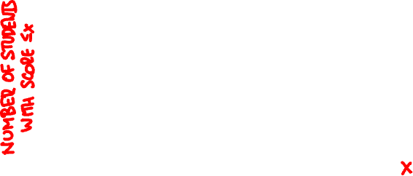
ENGG
ESTR

Slide 14



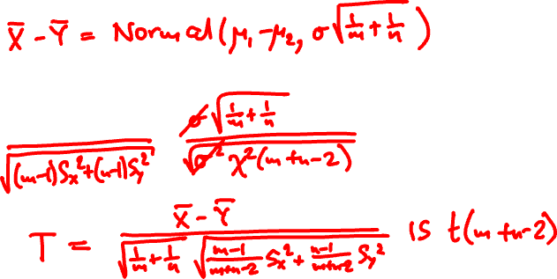
Normal means, unknown variance
X₁, …, X_{m} are Normal(μ₁, σ)
independent
Y₁, …, Y_{n} are Normal(μ₂, σ)

Slide 15
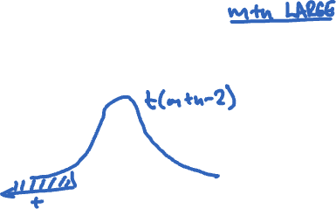


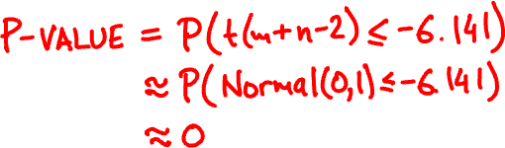


What is the p-value for hypothesis
“ESTR students do better on final”

Slide 16


Observational vs. Randomized
Observational study
No control over differences in population
Are ESTR students better prepared? More
skilled? Better at taking tests?
Randomized controlled experiment
Assign subjects to treatment randomly

Slide 17
final (out of 70)
midterm (out of 60)

Slide 18
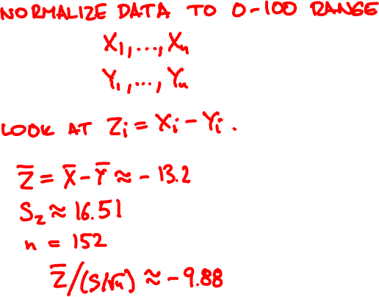
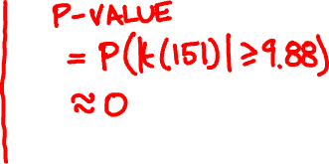



Is there a difference in performance between midterm and final exams?

Slide 19
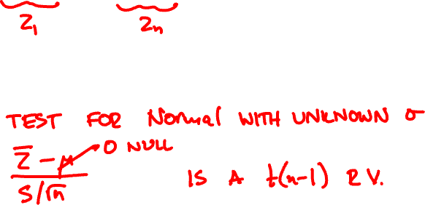
Paired t-test
X₁ – Y₁, …, X_{n} – Y_{n} independent Normal(μ, σ)
Null hypothesis: μ = 0

Slide 20
