Slide 1
11. CLIQUES
CSI 2101: Discrete Structures
Andrej Bogdanov

Slide 2
cliques and independent sets
Theorem: Among any 6 people there is a group of 3 friends or a group of 3 strangers.

Slide 3
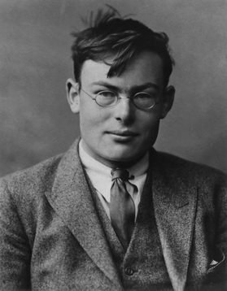
Frank Ramsey (1906-1930)

Slide 4
Ramsey’s theorem
For every k there exists n so that every n-vertex graph has a k-clique or a k-independent set.

Slide 5
Claim 1: Every graph of size 3 has a clique of size 2 or an independent set of size 3.
Claim 2: Every graph of size 3 has an ind set of size 2 or a clique of size 3.

Slide 6
Theorem: Every graph of size 6 has a clique of size 3 or an independent set of size 3.

Slide 7
P(n, k, i): Every graph of size n has a clique of size k or an independent set of size i.
Claim:

Slide 8
Claim 2: P(n, k, i) and (n’ > n) → P(n’, k, i)
For every k there exists n so that every n-vertex graph has a k-clique or a k-independent set.

Slide 9
Ramsey numbers
R(k, i) = smallest n for which P(n, k, i) is true

Slide 10
R(3, 3) =
R(4, 4) =
R(5, 5) =

Slide 11
Erdős asks us to imagine an alien force, vastly more powerful than us, landing on Earth and demanding the value of R(5, 5) or they will destroy our planet. In that case, he claims, we should marshal all our computers and all our mathematicians and attempt to find the value.
But suppose, instead, that they ask for
R(6, 6). In that case, he believes, we should attempt to destroy the aliens.
Joel Spencer

Slide 12
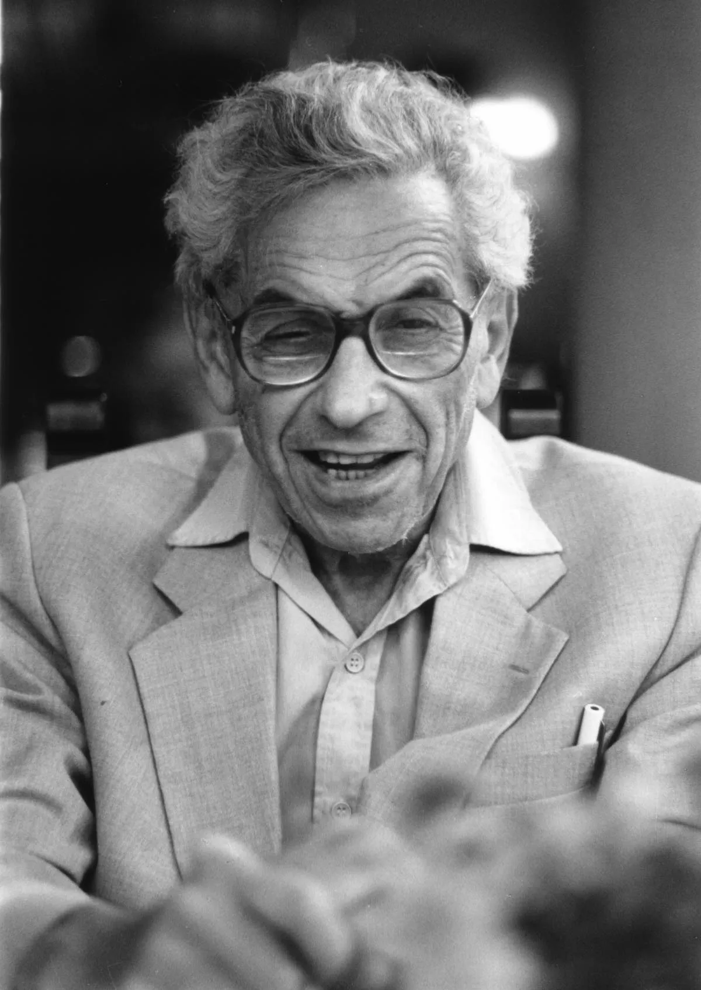
Paul Erdős (1913-1996)

Slide 13
How large a graph can I create so it has no k-clique and no k-independent set in it?

Slide 14
sum rule: If A₁, …, A_{n} are disjoint then
|A₁ ∪ ... ∪ A_{n}| = |A₁| + ... + |A_{n}|
union bound:

Slide 15
|A| = |n-vertex graphs| =
|B| = |n-vertex graphs with k-clique|

Slide 16
Theorem: If then R(k, k) > n

Slide 17
½√2^{k} ≤ R(k, k) ≤ 4^{k}
Campos, Simon, Morris, Sahasrabuthe (2023):
R(k, k) ≤ 3.993^{k}
for large k

